Slide 1
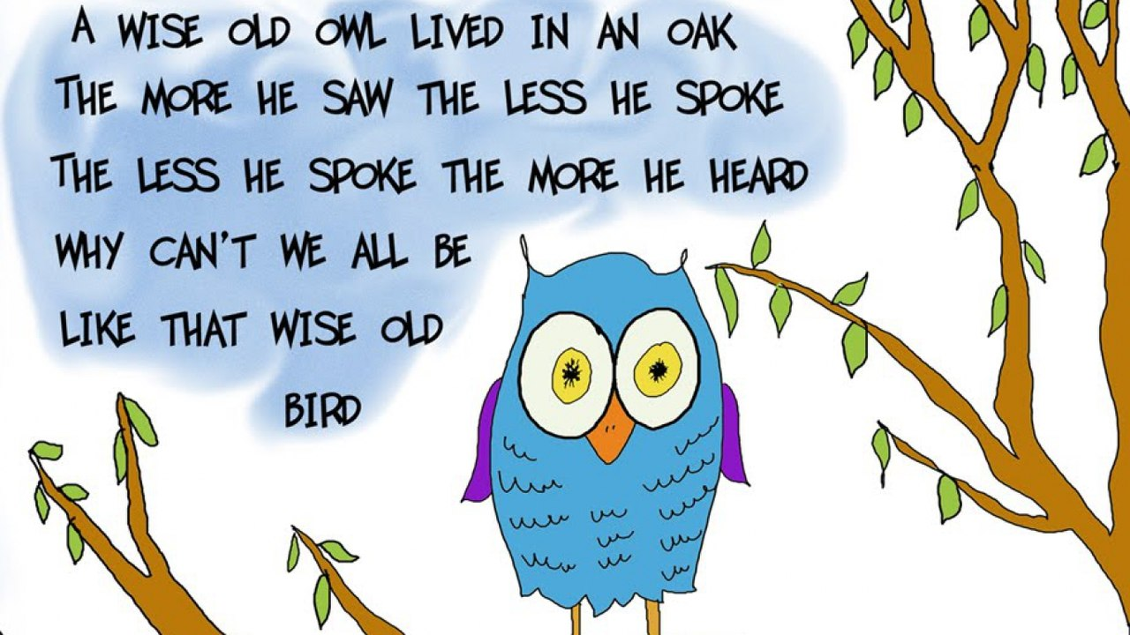

Slide 2
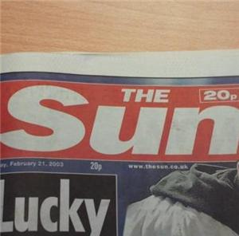
What is the topic of our lesson?

Slide 3
MASS MEDIA

Slide 4
What are the aims of our lesson?
TO LEARN NEW WORDS;
TO DO EXERCISES;
TO TALK ABOUT MASS MEDIA;
TO DO READING AND LISTENING TASKS;
TO DISCUSS DIFFERENT TYPES OF MEDIA.

Slide 5
CHECKING HOMEWORK
Telling stories
“My contact with aliens”

Slide 6
newspapers
A Tabloid is a newspaper with half-size pages; includes sensational crime stories, astrology, and celebrity gossip; is yellow press, easy for reading.
A Broadsheet is a serious, quality and independent newspaper.

Slide 7
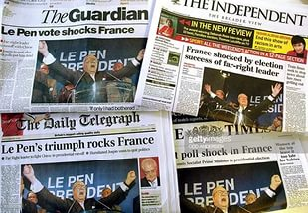
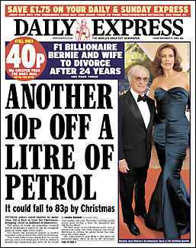
What types of newspapers are these? A tabloid or a broadsheet?

Slide 8
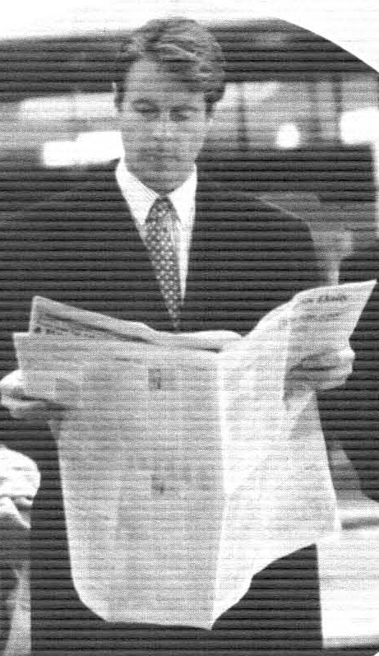

Slide 9
Match the words to the definitions
1.Tabloid
2.Broadsheet
3.Article
4.Headline
5.Advert
6.Review
7.Editor
8.Circulation
a) a title in large letters above the report, article
b) a person in control of the daily production
c) an article giving an opinion of new films, books, etc.
d) a newspaper that has got short articles, lots of pictures.
e) words and pictures about a product, to make people buy it.
f) a newspaper that has got longer articles, more serious news.
g) a piece of writing about an important subject.
h) number of readers.

Slide 10
Answers: 1) d 2) f 3) g 4) a 5) E 6) c 7) b 8) h

Slide 11
Reading comprehension internet newspapers and radio magazines and tv 1) 2) 3) … with the help of……. You can

Slide 12
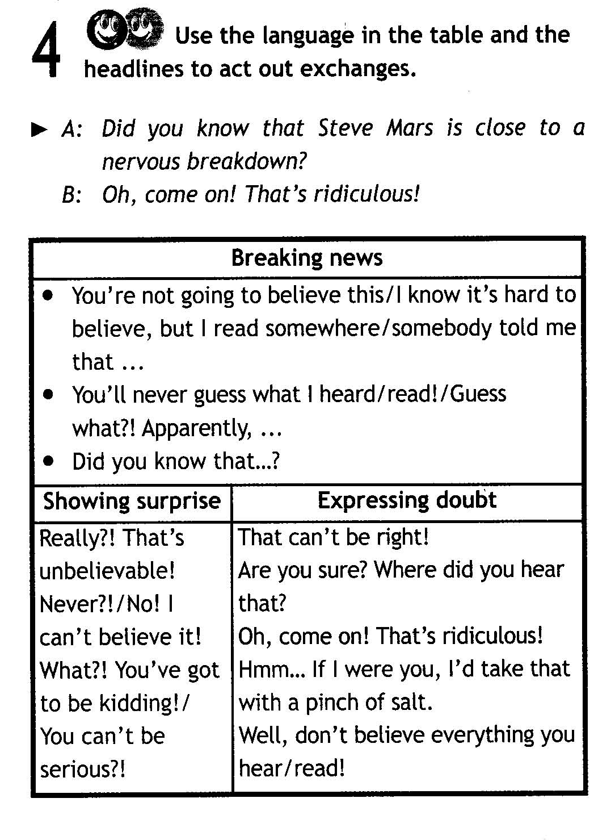
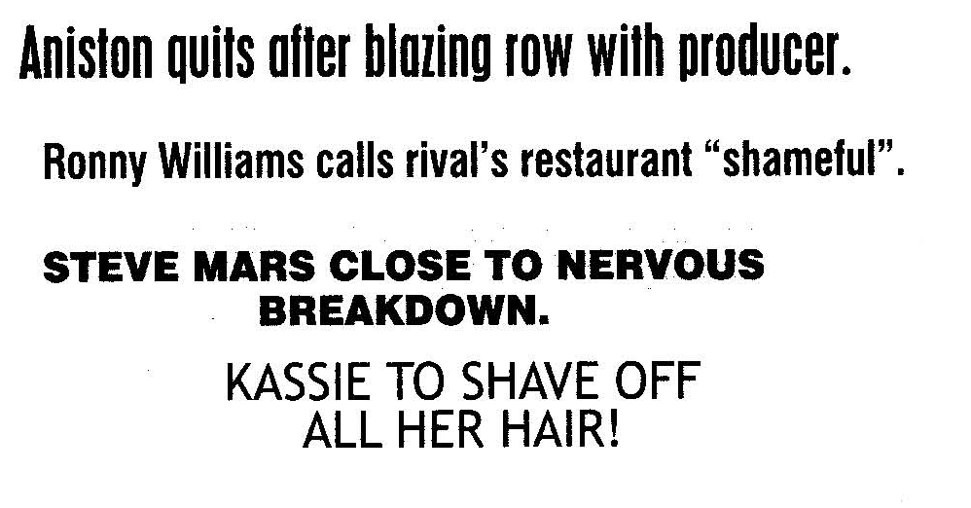
apparently – очевидно
ridiculous – нелепый, смешной
blazing row – яростный спор
rival - соперник

Slide 14
What Rubrics Do you Know?
Poli
Eco
Soci
Sci
Cul
Show-
Edu
Hea
Spo
Au
Hou
Hu
Fina
lth
mour
ture
cation
ence
tics
nomy
tos
ety
sing
business
nce
rts

Slide 15
Answers:
Politics
Economy
Society
Science
Culture
Show-business
Education
Health
Sports
Autos
Housing
Humour
Finance

Slide 16
1.Which rubrics do you prefer?
2.What types of mass media do you use to keep up on news?
3.What is your favourite one?
Politics
Economy
Society
Science
Culture
Show-business
Education
Health
Sports
Autos
Housing
Humour
Finance
As for me…
I prefer…
I tend to think that…
It seems to me...
Moreover, I …
In my opinion…
To my mind, …
As far as I’m concerned….

Slide 17
Homework:
a project “Pros and cons of mass media”.

Slide 18
reflection

Slide 19
Ladder of success
EXCELLENT
GOOD
NOT BAD

